Slide 1

CACHE CREEK MMM
1.30.2024
BY: ROHAN
03.05.2021

Slide 2
IDEA OF MMM

Slide 3
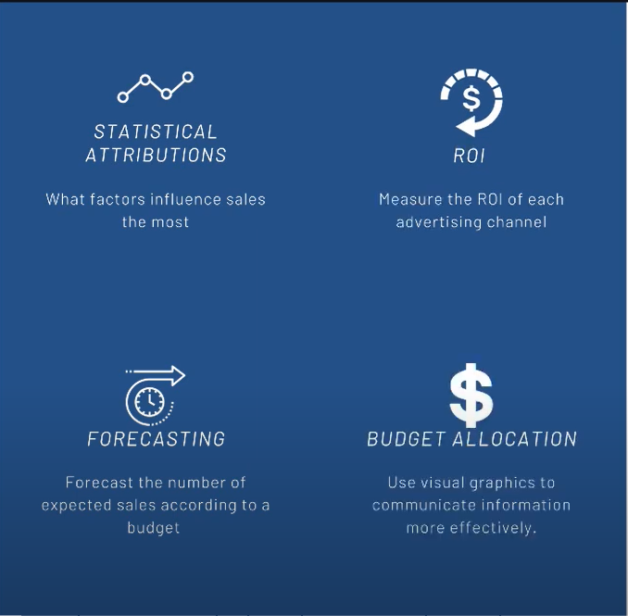
WHAT IS MMM
Definition: Statistical Techniques applied to historical data to understand the marginal contribution of each individual factor on sales.
Source: Use the source type style

Slide 4
Competition
Ad:Offline Digital
Price and Promos
MMM
External factors
Seasonal trends

Slide 5
THE PROCESS
Optimize
Budget Allocation
Forecast
Number of Visits
Measure
Variable Impact, ROI

Slide 6
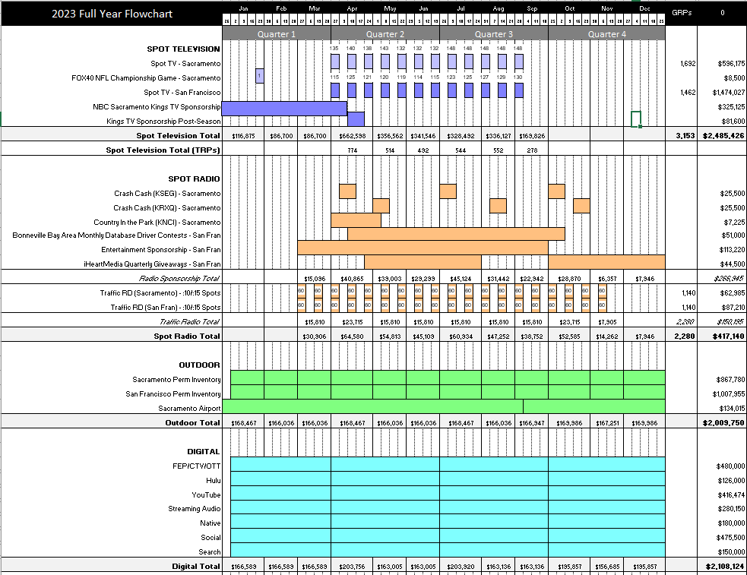
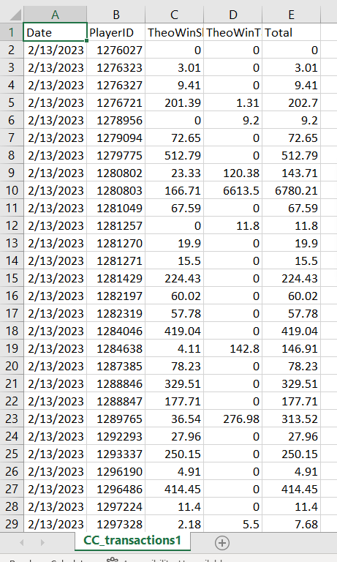
data

Slide 7
EVENT LIST
Concert Date | Artist/Band | (announce date) | (on-sale date) | LIVE DATES
 |  |  |  | Digital OOH | Web Display | Social | Radio Donut | Paid Search | Pandora |  | Donuts Live Dates:
 | Jay Leno |  |  | 12/29/2021 | 1/24/2022 | 1/21/2022 | Not Applicable | 1/7/2022 | 1/26/2022 |  | APR | 2/28/2022
 | Slash |  |  | 12/29/2021 | 1/31/2022 | 1/21/2022 |  | 1/9/2022 | 1/26/2022 |  | MAY | 4/4/2022
 | Tyler Henry |  |  | 12/9/2021 | 1/31/2022 | 1/21/2022 |  | 1/8/2022 | 1/26/2022 |  | JUN | 5/9/2022
2-Apr | Daniel Tosh | 31-Jan | 4-Feb | 2/2/2022 | 2/14/2022 | 2/4/2022 | 2/28/2022 | 1/7/2022 | 2/16/2022 |  | JUL | 6/13/2022
9-Apr | Michael Bolton | 31-Jan | 4-Feb | 2/2/2022 | 2/14/2022 | 2/4/2022 | 2/28/2022 | 2/8/2022 | 2/16/2022 |  | AUG | 7/11/2022
6-May | Mariachi Divas | 15-Mar | 18-Mar | 3/30/2022 | 3/30/2022 | 3/29/2022 | 4/4/2022 | No Volume | 4/25/2022 |  | SEPT | 8/8/2022
7-May | Thunder From Down Under | 16-Mar | 18-Mar | 4/3/2022 | 3/30/2022 | 3/29/2022 | 4/4/2022 | 4/5/2022 | 4/25/2022 |  | OCT
13-May | Lea Salonga | 22-Mar | 25-Mar | 4/3/2022 | 3/30/2022 | 3/29/2022 | 4/4/2022 | 3/29/2022 | 4/25/2022 |  | NOV
4-Jun | The Jacksons | 6-May | 6-May | 5/11/2022 | 5/16/2022 | 5/13/2022 | 5/9/2022 | 5/11/2022 | 5/17/2022 |  | DEC
10-Jun | Culture Club | 19-Apr | 22-Apr | 5/2/2022 | 4/25/2022 | 4/27/2022 | 5/9/2022 | 5/11/2022 | 4/27/2022 |  | JAN
25-Jun | Chris Tucker | 4-May | 6-May | 5/11/2022 | 5/16/2022 | 5/6/2022 | 5/9/2022 | 5/11/2022 | 5/17/2022
1-Jul | Clint Black | 10-May | 13-May | 5/11/2022 | 5/16/2022 | 5/13/2022 | 6/13/2022 | 5/16/2022 | 5/17/2022
9-Jul | Drumline Live | 18-May | 20-May | 5/31/2022 | 6/2/2022 | 6/6/2022 | 6/13/2022 | 7/3/2022 | 6/6/2022
5-Aug | Theresa Caputo | 8-Jun | 10-Jun | 6/21/2022 | 6/24/2022 | ####### | 7/11/2022 | 1/7/2022 | 7/1/2022
6-Aug | Theresa Caputo | 8-Jun | 10-Jun
27-Aug | 70's Soul Jam | 6-Jul | 8-Jul | 7/15/2022 | 7/20/2022 | 7/19/2022 | 7/11/2022 | 7/21/2022 | 7/25/2022
9-Sep | Beach Boys | 19-Jul | 22-Jul | 7/26/2022 | 7/29/2022 | 9/1/2022 | 8/8/2022 | 7/26/2022 | 8/1/2022
1-Oct | Gary Valenciano | 10-Aug | 12-Aug | 9/1/2022 | 9/9/2022 | 9/6/2022 | 9/13/2022 | 9/9/2022 | 9/12/2022
8-Oct | Amy Schumer | 22-Mar | 25-Mar | 4/8/2022 | 4/11/2022 | 4/13/2022 |  | 5/12/2022 | 4/21/2022
29-Oct | Boxing | TBD | TBD | 10/3/2022 | 10/5/2022 | 10/7/2022 | 9/13/2022 | 10/2/2022 | 10/13/2022
5-Nov | Train | 14-Sep | 16-Sep | 9/19/2022 | 9/26/2022 | 9/21/2022 | 10/3/2022 | 9/30/2022 | 9/23/2022
12-Nov | Wheel of Fortune Live! | 17-May | 20-May | 6/21/2022 | 6/24/2022 | 6/24/2022 |  | 6/27/2022 | 7/1/2022
22-Jan | Tsai Chin | 30-Nov | 7-Dec
28-Jan | Legends of Motown | 7-Dec | 14-Dec

Slide 8
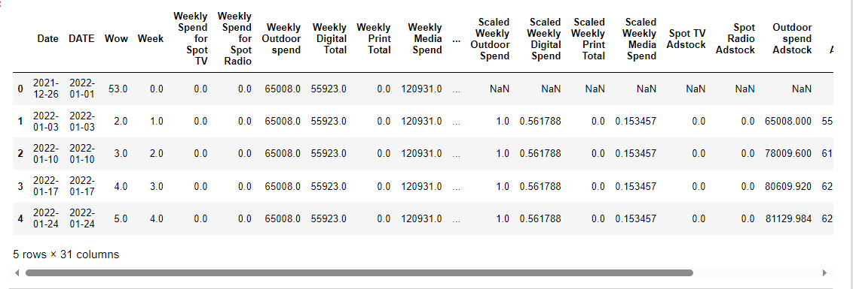
CLEANING AND MEASURING

Slide 9
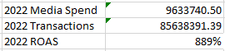
RETURN ON AD SPEND

Slide 10
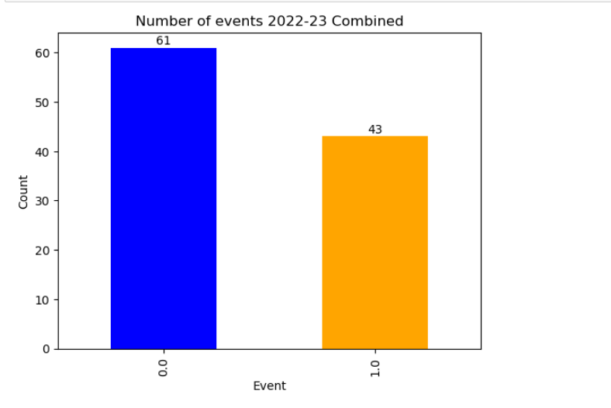
Events

Slide 11
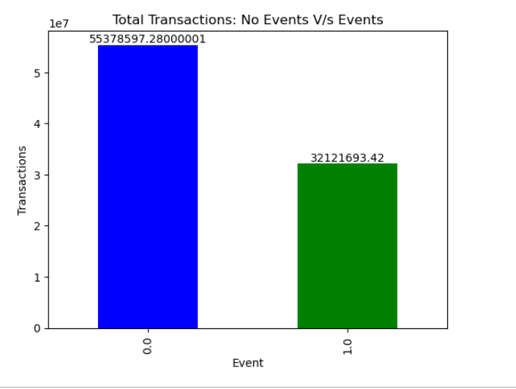
Total Transactions

Slide 12
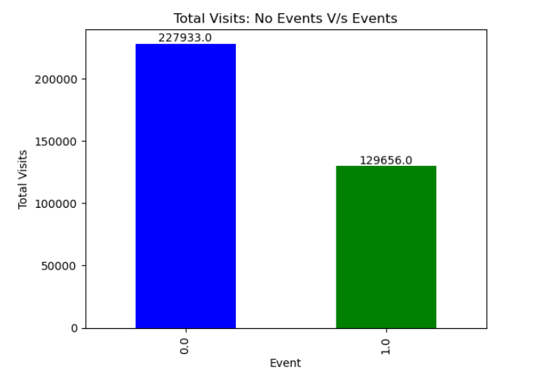
Total visits

Slide 13
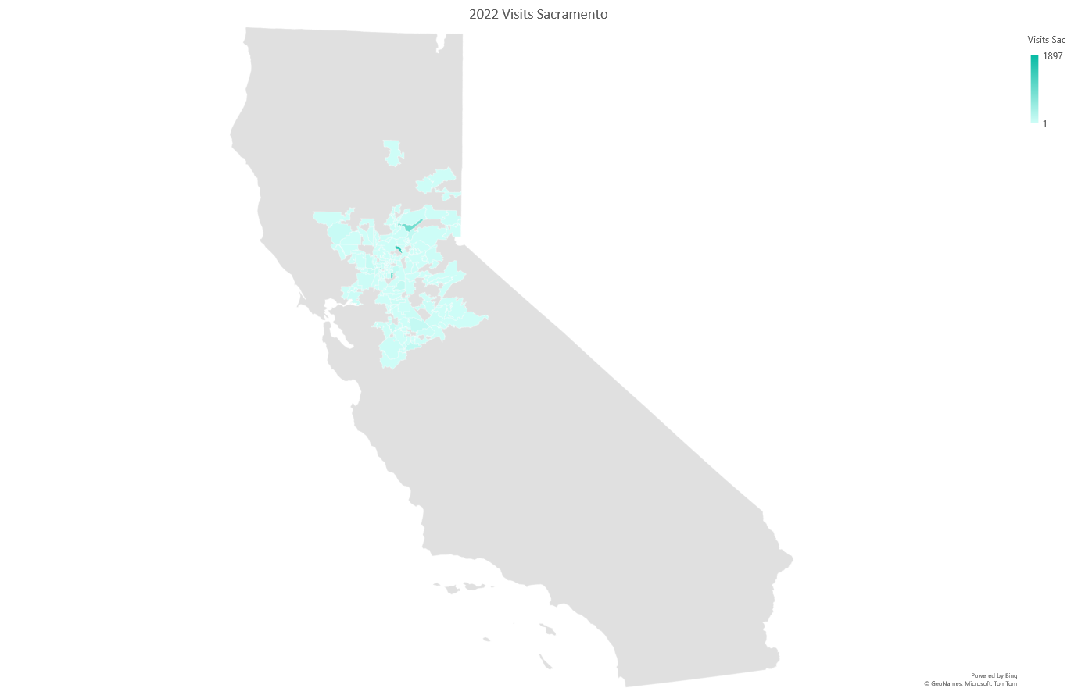
Visits from sacramento

Slide 14

VISIts from san Francisco

Slide 15
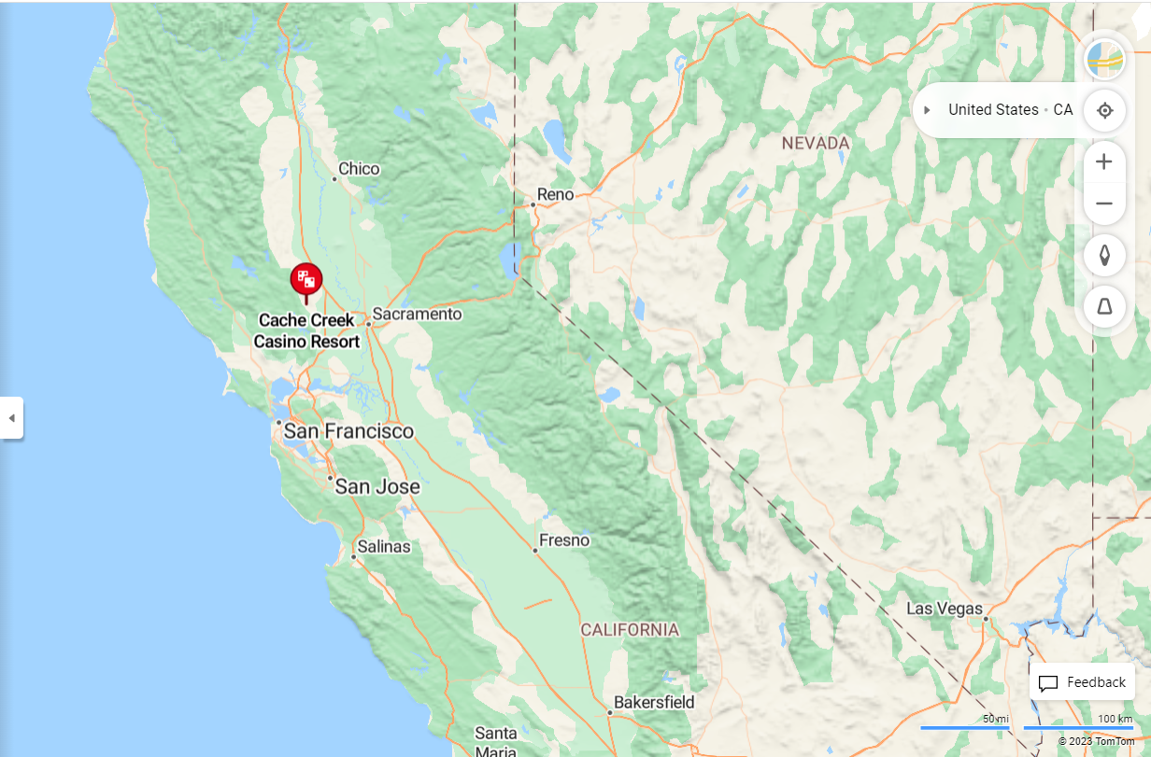

Slide 16
Visits from SF and Sacramento

Slide 17
POPULATION DATA

Slide 18
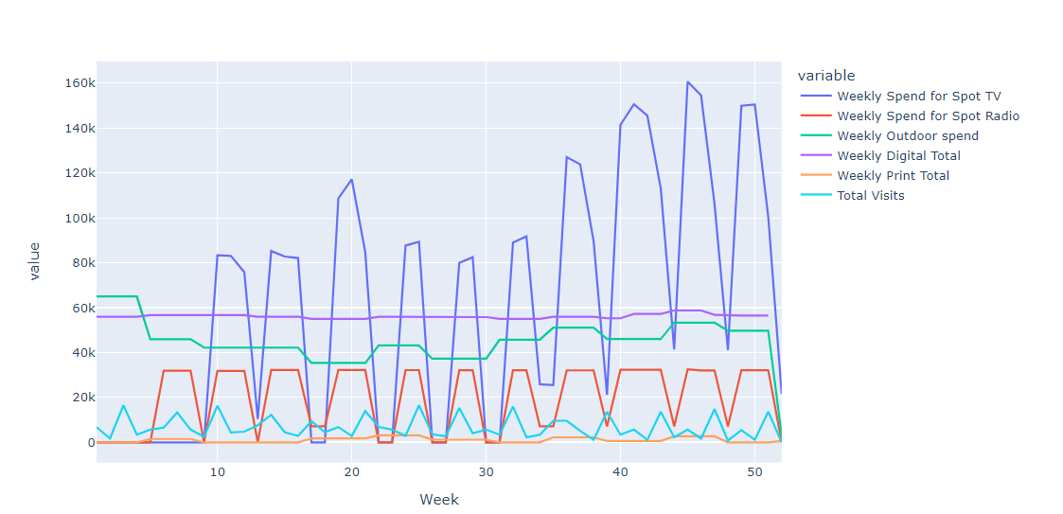
Total Visits by Channel

Slide 19
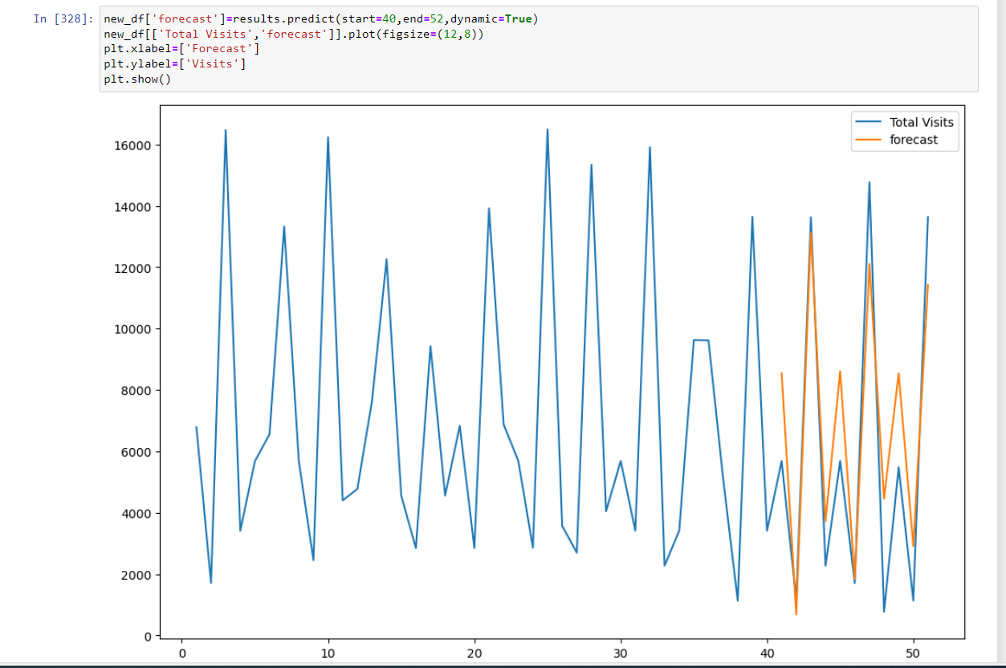
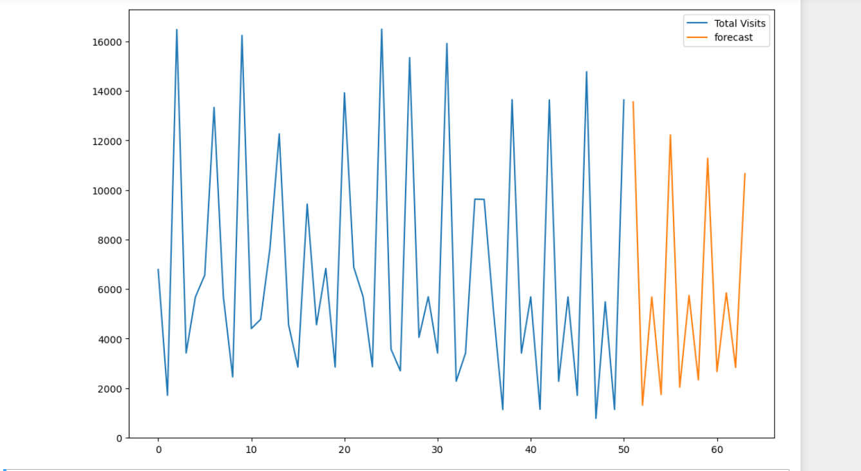
Forecasted visits

Slide 20
ADSTOCK

Slide 21
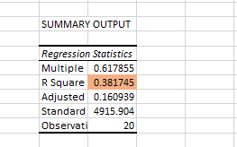
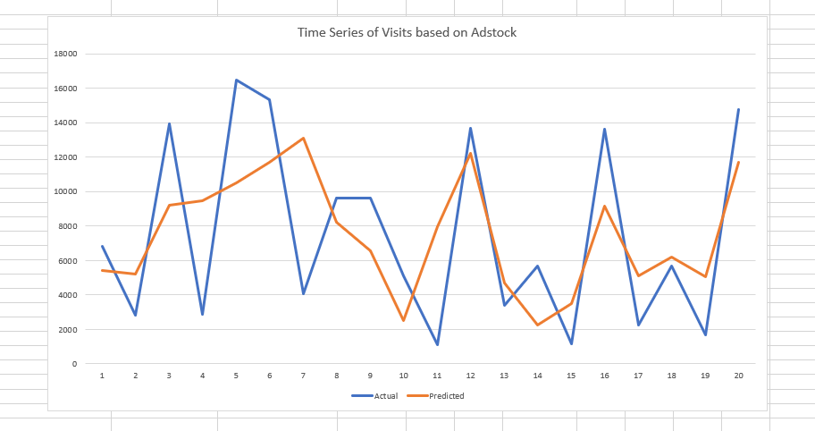
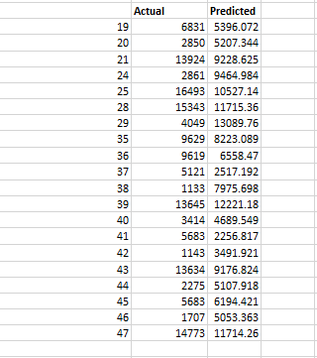
ADSTOCK PREDICTIONS

Slide 22
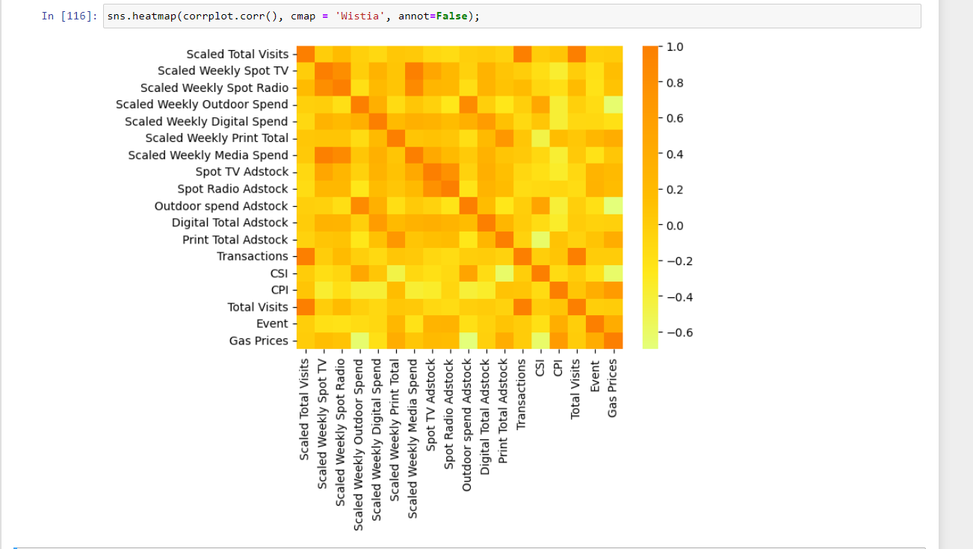
MODELLING RESULTS

Slide 23
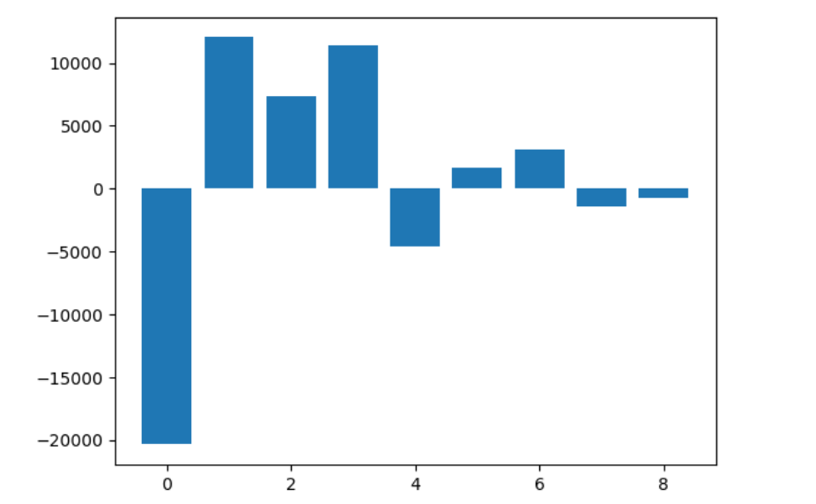

Slide 24
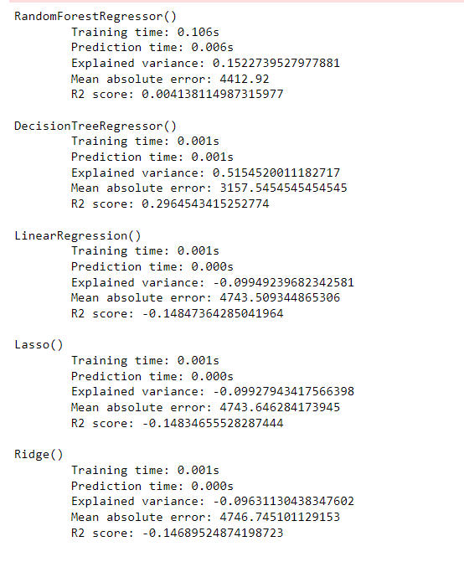
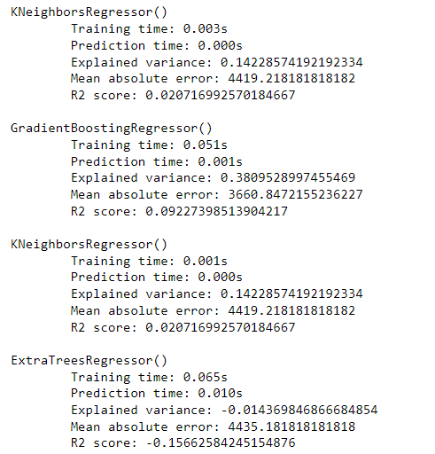
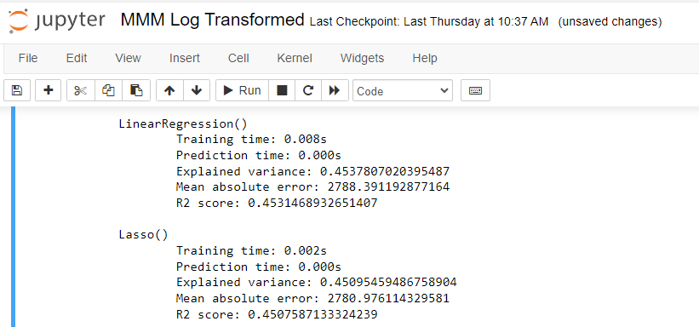

Slide 25
CAUSE FOR LOW R-squares
An RSQ that low could be caused by a number of things such as:
1) Incorrect input data
2) Incomplete input data
3) Completely missing relevant input variables that affect your output variable
4) Not enough historical data, if it's a new business with low spend and revenue volumes we might simply not be able to use MMM yet

Slide 26
OPTIMIZATION

